Slide 1
Claude for Developers
Best Practices
CLAUDE.md, context optimisation, and the workflows that make Claude actually useful
Nona Dzhurkova

Slide 2
What we'll cover
How Claude fits into your workflow
Surfaces & models (Code, API, chat)
The core loop
CLAUDE.md — what, where, what goes inside
.claudeignore — the honest answer
Optimisations & context hygiene
Power features: slash commands, subagents, hooks, MCP, skills
Common pitfalls
API best practices
Cheat sheet

Slide 3
How Claude fits in your workflow
Pair programmer
Plans with you, drafts code, runs tests, fixes what fails. Stays in the loop — you stay in control.
Works from your spec or a rough sketch
Reads context from CLAUDE.md and existing code
Asks before touching anything risky
Tireless reviewer
Audits diffs, spots edge cases, suggests refactors. Treats your CLAUDE.md as the standard to enforce.
Flags missing tests and untyped boundaries
Catches subtle regressions in long diffs
Never tires on the 12th PR of the day
Codebase explainer
Reads unfamiliar repos and explains them. Faster than grep, more accurate than guessing.
Traces a feature end-to-end across files
Summarises modules, callers, and side effects
Onboards new hires without senior time

Slide 4
…and beyond engineering
QA
Generates test cases from requirements and explores edges humans miss.
Drafts unit, integration, and E2E specs
Turns bug reports into reproductions
Reviews coverage gaps in pull requests
BA / Product
Turns stakeholder notes into structured requirements and user stories.
Drafts PRDs, acceptance criteria, flows
Summarises interviews and feedback
Pressure-tests scope against goals
SEO
Audits pages, clusters keywords, and writes briefs the content team can use.
Analyses SERPs and competitor pages
Builds topic clusters and internal links
Drafts metadata and schema markup
Marketing
Drafts campaigns, repurposes content, and keeps voice consistent across channels.
Blog posts, emails, social, ad copy
Repurposes one asset into many formats
Localises and adapts tone by audience

Slide 5
Pick the right surface for the job
Claude Code
Terminal, in your repo
Reads & edits files directly
Runs commands, tests, git
Loads CLAUDE.md automatically
Best for
Devs: shipping software
Ops & data: scripted workflows
Claude.ai
Browser chat, Projects, Connectors
Upload files, connect Drive
Projects = shared context
Connectors: Gmail, Slack, Jira, Notion
Best for
Anyone: research & drafting
Teams: shared knowledge base
Claude API & Apps
Programmatic access + integrations
SDKs for Python, TS, etc.
Tool use & structured output
Lives in Slack, Office, desktop apps
Best for
Devs: app integration at scale
Non-devs: no-code via Zapier, Make

Slide 6
Claude shows up everywhere you work
In Office & the browser
PowerPoint add-in — built this deck
Excel add-in — formulas, models, charts
Word, Outlook — drafting, meeting prep
Chrome extension — Claude on any webpage
Mobile app — iOS, Android
Surfaces talk to each other via MCP.
In your stack
Anthropic API — direct SDK access
AWS Bedrock — enterprise hosting
Vertex AI — Google Cloud
Microsoft Foundry — Azure integration
Agent SDK — build your own agents
Same model, your infra.
In your editor
Claude Code CLI — terminal-first agent
VS Code extension — sidebar chat, inline edits, diff view
JetBrains plugin — IntelliJ, PyCharm, WebStorm
GitHub Actions — PR reviews, issue triage
Same CLAUDE.md, different UI.

Slide 7
Models: which Claude when?
Rule of thumb: start on Sonnet → drop to Haiku for volume → escalate to Opus for hard problems
Haiku 4.5
The volume workhorse
$1 / $5 per MTok • 200K ctx • fastest tier
Devs
Classification, routing, light extraction
Cheap layer in front of bigger models
Non-devs
Tagging & sorting bulk emails or tickets
Quick Q&A over a doc or PDF
Skip for: multi-step reasoning, complex codegen.
Sonnet 4.6
The default — start here
$3 / $15 per MTok • 200K (1M beta) • 79.6% SWE-bench
Devs
Day-to-day coding in Claude Code
Feature work, refactors, bug fixes
Non-devs
Drafting, editing, summarising
Doc analysis, research, RAG answers
Within 1.2 pts of Opus at 40% the cost.
Opus 4.8
The flagship — escalate to it
$5 / $25 per MTok • 1M ctx • top SWE-bench
Devs
Architecture, hard refactors, big codebases
Long agentic sessions / agent teams
Non-devs
Deep research across many sources
Complex multi-step strategy or analysis
~4× more reliable than Opus 4.7.

Slide 8
The core loop: Plan → Context → Ask → Iterate
01
Plan
Get the approach right before you act. Ask Claude to think it through — and push back if something feels off.
Devs
Use plan mode before any code runs
Non-devs
Ask for an outline or strategy first
02
Context
Give Claude what it needs. The right background, docs, and constraints save more time than a perfect prompt.
Devs
Point at the relevant files and paths
Non-devs
Upload the brief, doc, or data you have
03
Ask
Be specific. State the goal, constraints, and what done looks like. Examples beat adjectives.
Devs
Name the file, function, or behaviour
Non-devs
Name the audience, tone, and format
04
Iterate
Review, refine, course-correct. When Claude goes off-track, start a fresh thread — don't pile fixes.
Devs
Use /rewind in Claude Code to roll back
Non-devs
Restart with a tighter, cleaner prompt

Slide 9
CLAUDE.md
Your project's memory
The single most impactful file you can add to a repo using Claude Code

Slide 10
What is CLAUDE.md?
A plain Markdown file Claude reads at the start of every session.
Persistent: Loaded into context before your first message. Survives /compact.
Project-specific: Captures conventions, commands, and gotchas you'd otherwise re-explain every session.
Context, not enforcement: Claude treats it as instructions, not hard rules. Use hooks if you need to block actions.
Think of it as: the onboarding doc you'd hand a new teammate on their first day.
Tip: run /init in your repo to bootstrap a starter CLAUDE.md.

Slide 11
Where CLAUDE.md lives — and how it loads
~/.claude/CLAUDE.md
Global
Your personal preferences across every project — coding style, tools you favour, default behaviours.
Loaded everywhere
<repo>/CLAUDE.md
Project
Team-wide conventions for this repo. Commit it. Build commands, architecture, testing rules.
Survives /compact
<subdir>/CLAUDE.md
Directory
Scoped rules for one part of the codebase (frontend, infra). Loaded lazily when Claude reads files there.
On demand
CLAUDE.local.md
Personal
Your private overrides for this repo. Add to .gitignore. Never shared with the team.
Gitignored

Slide 12
What goes inside — and what doesn't
DO include
Build, test, lint commands you actually run
Project structure & key file locations
Code style rules unique to this repo
"Always do X" / "Never do Y" constraints
Domain terms with a precise meaning
Known gotchas: flaky tests, slow services, traps
DON'T include
Generic advice ("think step by step") — Claude already tries
Personality prompts ("act as a senior engineer")
Anything Claude can read from the code itself
Long architecture docs — link or @-import instead
Secrets, tokens, or anything sensitive
Bloat: aim for 80–120 lines, hard cap ~200

Slide 13
Example: a tight project CLAUDE.md
# Acme API
## Stack
- Node 22, TypeScript strict, Fastify, Postgres 16
- Tests: Vitest. Lint: Biome. Migrations: drizzle-kit.
## Commands
- Dev: `pnpm dev` (port 3000, watches src/)
- Test: `pnpm test` (must pass before any commit)
- Lint: `pnpm check` (Biome — fix with `--write`)
## Conventions
- Never import from `dist/`. Use path aliases (`@/...`).
- New routes go in `src/routes/`; register in `app.ts`.
- Errors use `AppError` from `src/errors.ts` — never throw strings.
## Gotchas
- `pnpm test:e2e` needs Docker running.
- Migrations: `drizzle-kit generate` before `migrate`. Do not edit SQL by hand.

Slide 14
Controlling file access: use settings.json
⚠ .claudeignore is NOT working
Not an officially supported feature
Claude Code still reads .env and other "ignored" files (verified Jan 2026)
Even .gitignore is bypassed for read access
Do not rely on it for secrets — use settings.json deny rules
Treat .env, *.pem, credentials.json as security-critical — settings.json is the only enforced boundary today.
✓ The real solution: .claude/settings.json
{
"permissions": {
"deny": [
"Read(.env)",
"Read(.env.*)",
"Read(*.pem)",
"Read(secrets/**)",
"Read(node_modules/**)"
]
}
}
Enforced via PreToolUse hooks
Commit per-project, also supports user/managed scopes

Slide 15
Context optimisation playbook
Keep CLAUDE.md lean
Target 80–120 lines. Models reliably follow ~150 instructions; your file competes with the system prompt.
Use @-imports for big rules
@docs/api-style.md keeps the root file short. Imports expand inline, so they don't save tokens — but they keep things organised.
Scope rules to paths
Frontmatter paths: globs load rules only when matching files are touched. Don't pay for Python rules on a React PR.
Reference files, don't paste them
"Read src/auth/session.ts before refactoring" beats pasting 800 lines into the prompt.
/clear > /compact for new work
Compact summarises; clear starts fresh. If you're switching tasks, clear.
Manually /compact before auto fires
Auto-compact runs at the worst possible moment. Trigger it yourself when context is still coherent.
Push exploration to subagents
Spawn a subagent to grep, summarise, or explore — only its final report comes back to your main context.
Use /rewind, not correction stacking
When Claude takes a wrong turn, double-Esc to rewind. Don't pile fixes on a polluted thread.

Slide 16
The Claude Code extensibility surface
SHORTCUTS
Slash commands
Reusable prompts stored as markdown files. Invoke with /name.
Project-scoped (git-tracked)
.claude/commands/
Personal (all repos)
~/.claude/commands/
Inside the file
Plain markdown — content is the prompt
Use $ARGUMENTS for dynamic input
e.g. /review, /standup, /scan
PARALLELISM
Subagents
Isolated Claude instances that run a task and return only their result — keeps your main context clean.
How to invoke
Tell Claude: "Use a subagent to..."
Or: "In parallel, spawn agents that..."
Claude uses the Task tool internally
Good for
Auditing multiple files at once
Research across many sources
Any work you'd open a new tab for
GUARDRAILS
Hooks
Shell commands that fire before or after tool calls. The only true enforcement layer in Claude Code.
Two types
before_tool — can block the action entirely
after_tool — runs after, good for logging
Common uses
Block reads of .env, secrets, certs
Log every file write to an audit trail
Run linter/formatter after each edit
Where to define
settings.json → hooks:
EXTERNAL CONTEXT
MCP + Skills
Connect Claude to live data sources. Skills bundle a server + prompt into a single /command.
Add a server
claude mcp add <name> <cmd>
Popular servers
GitHub — PRs, issues, code search
Filesystem — broader path access
Sqlite / Postgres — query your DB
Browser — fetch, screenshot pages
Skills
Markdown file: server + tools + prompt
Invoke with /skill-name like a command

Slide 17
Slash commands: prompts as files
WHAT THEY ARE
Reusable prompts stored as markdown files. Type /name to invoke any of them mid-session.
WHERE THEY LIVE
Project: .claude/commands/
Personal: ~/.claude/commands/
WHEN TO REACH FOR ONE
Repeatable workflow: code review, release notes, PR description
Anything you type more than twice belongs here
EXAMPLE
.claude/commands/review-pr.md
---
description: Review the open PR
---
Run gh pr view --json title,body
then review the diff against our
style guide. Flag:
- Missing tests
- Public API changes
- Anything touching auth
Now: /review-pr

Slide 18
Subagents: protect your context
WHAT THEY ARE
A separate Claude instance with its own context window. You give it a task, it does the work, only its final report comes back.
WHY THIS MATTERS
The highest-leverage token move: push exploration into subagents and keep your main context clean for the actual work.
GOOD CANDIDATES
"Find every place we call the auth API"
Code review against a checklist
Reading docs to extract one answer
Running parallel audits across multiple services
DEFINE ONE
.claude/agents/security-review.md
---
name: security-review
description: Audit a diff for
injection, authz, secrets.
tools: Read, Grep, Bash
memory: project
---
You are a security reviewer.
Read the diff, score each
finding L/M/H, return JSON.
Restrict tools to the minimum.

Slide 19
Hooks: the actual guardrails
WHAT THEY ARE
Shell commands Claude Code runs before or after every tool call. Exit code 2 blocks the action — deterministically.
EVENTS YOU CAN HOOK
PreToolUse — block reads, writes, bash
PostToolUse — auto-format on write
Stop — run tests at end of turn
WHEN TO USE
Anything that MUST happen — block secrets, run prettier, push to CI. CLAUDE.md is guidance; hooks are enforcement.
BLOCK READS OF .env
.claude/settings.json
{
"hooks": {
"PreToolUse": [{
"matcher": "Read",
"hooks": [{
"type": "command",
"command":
"./guard-env.sh"
}]
}]
}
}
Script exits 2 ⇒ blocked.

Slide 20
MCP: plug Claude into your stack
ADD AN MCP SERVER
claude mcp add github \
-- npx -y \
@modelcontextprotocol/
server-github
SCOPES
--scope local: this machine only
--scope project: shared via .mcp.json
--scope user: across all projects
Vet the server before installing — MCP tools can run on every session.
WHAT IT IS
Model Context Protocol — an open spec for connecting Claude to external systems. Anthropic-built, now an industry standard.
WHAT YOU GET
GitHub, Jira, Linear — read issues, open PRs
Postgres, Sentry — query data or errors live
Slack, Notion — pull thread context, drop notes
Filesystem, Puppeteer — bigger sandbox
WHY IT MATTERS
Stop copy-pasting tickets and stack traces. Let Claude fetch the source.

Slide 21
Skills: package your workflows
WHAT THEY ARE
Self-contained folders that bundle instructions, scripts, and reference files. Claude loads them only when relevant — no context cost until used.
SKILL vs SLASH COMMAND
Slash command: one prompt, you invoke it
Skill: multi-file workflow, Claude reaches for it when the description matches
GOOD FITS
Onboarding flow for a new microservice
Release process: changelog + tag + notes
Anything with a runbook + helper scripts
STRUCTURE
.claude/skills/release/
SKILL.md
scripts/
bump-version.sh
references/
changelog-style.md
SKILL.md frontmatter
---
name: release
description: Cut a release —
bump version, draft notes,
tag, and open the PR.
---
Description is the trigger — write it for the moment you want Claude to grab the skill.

Slide 22
Common pitfalls
Patterns that slow teams down — and what to do instead

Slide 23
Pitfalls — and what to do instead
✗ Bloated CLAUDE.md (300+ lines)
→ Trim to essentials. Move detail into @-imports or path-scoped rules.
✗ Vague prompts ("fix this bug")
→ Name the file, the symptom, the expected behaviour. Give an example.
✗ Trusting .claudeignore for secrets
→ It isn't a built-in. Use settings.json deny rules or keep secrets outside the workspace.
✗ Endless /compact in one session
→ /clear when switching tasks. Long sessions degrade — start fresh.
✗ Personality prompts in CLAUDE.md
→ "Be a senior engineer" doesn't help. Specific rules do: "All API routes use Zod schemas."
✗ Letting Claude grep the whole repo
→ Point it at the files. "Read src/auth/*.ts before changing the login flow."
✗ Stale CLAUDE.md after refactors
→ Review monthly. Out-of-date conventions are worse than no conventions.
✗ Skipping plan mode for risky work
→ Migrations, deletes, infra: always plan first. Review before execution.

Slide 24
The cheat sheet
1. Write a CLAUDE.md. Commands, conventions, gotchas. 80–120 lines. Run /init to start.
2. Scope rules to where they matter. Use subdirectory CLAUDE.md files and path-scoped rules.
3. Be specific. Name files. State constraints. Show examples. Vague prompts = vague code.
4. Treat context like a budget. /clear between tasks. Push exploration to subagents. /rewind when wrong.
5. Don't rely on .claudeignore for security. Use settings.json deny rules or keep secrets out of the workspace.
6. Plan first, then build. For risky changes — migrations, refactors, infra — always start in plan mode.
7. Use slash commands. Turn every repeated task into a /command. Drop a markdown file in .claude/commands/ and invoke by name.
8. Use agents to optimise work. Delegate deep searches, parallel audits, and heavy research to subagents. Keep your main context for what matters.
Docs: docs.claude.com · code.claude.com/docs · /memory and /help inside Claude Code

Slide 25
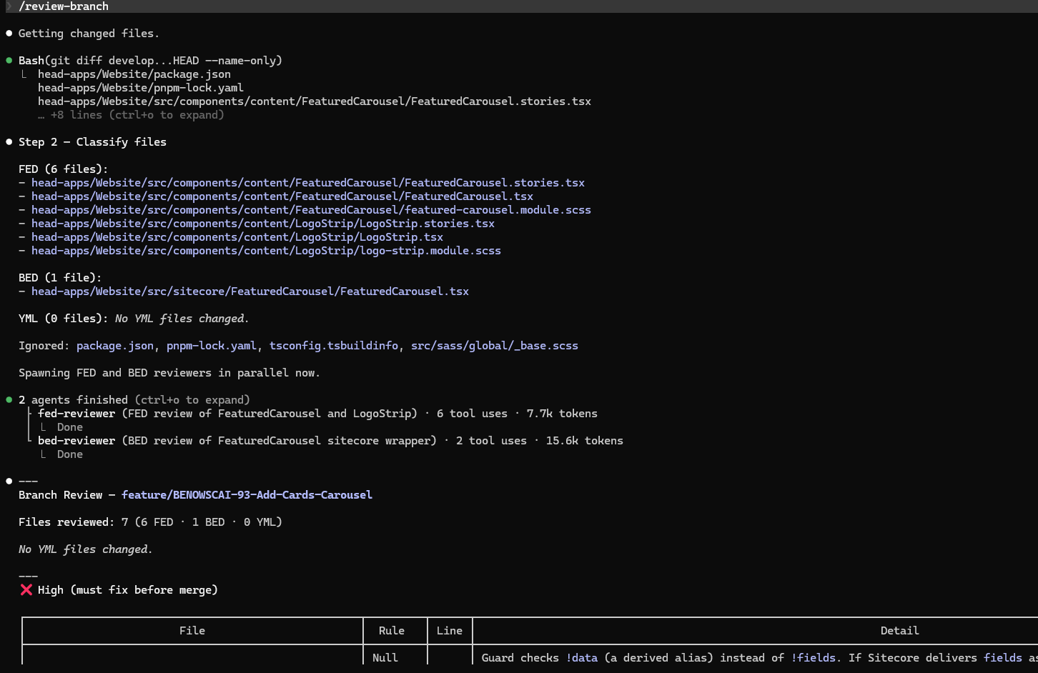
In practice: /review-branch
SLASH COMMAND + SUBAGENTS
A single /command that classifies changed files by team, then spawns a dedicated reviewer subagent for each layer — in parallel.
What it does
Runs git diff to get changed files
Classifies into FED, BED, YML layers
Spawns one reviewer subagent per layer
Returns a unified review report
Why it works
Reviewers run in parallel — no waiting
Each subagent context is isolated and lean
One command replaces a manual review workflow

Slide 26
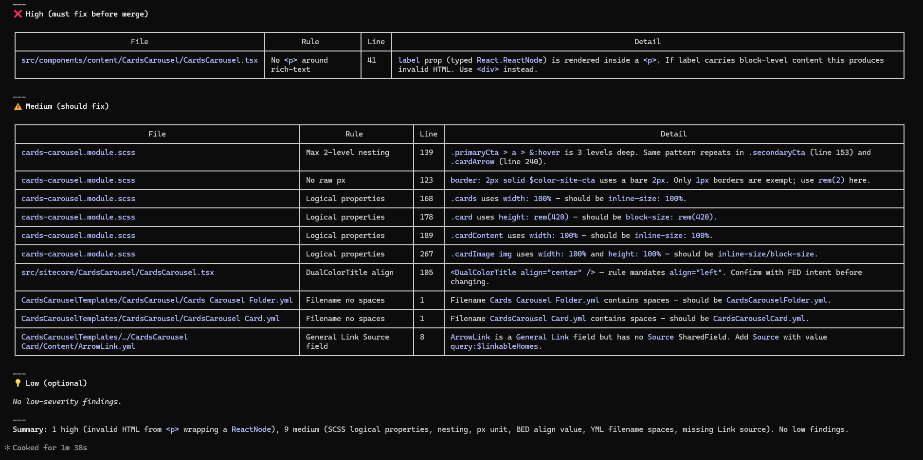
Output: graded review report

Slide 27
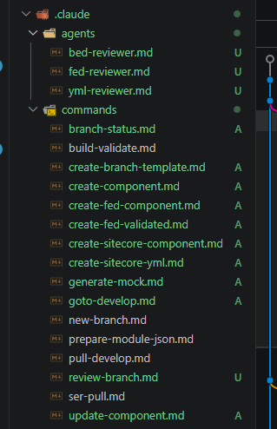
Inside .claude/
THE FULL LIBRARY
Every agent and command is just a markdown file. Checked into git, versioned, and shared across the team.
agents/
One file per specialist — bed-reviewer, fed-reviewer, yml-reviewer
Each defines name, tools, memory scope, and system prompt
Invoked automatically by commands like /review-branch
commands/
create-component, create-fed-component
generate-mock, build-validate
review-branch, branch-status
16 commands covering the full dev workflow
New teammate runs /review-branch on day one

Slide 28
Questions?
docs.claude.ai · code.claude.com/docs

Slide 29
Thank you
Now go ship something.

